Slide 1
The mechanics of building teams
Leveraging Peer Insights
Yelp for dining, Amazon for shopping, now Teamanics for hiring

Slide 2
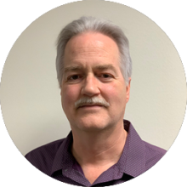
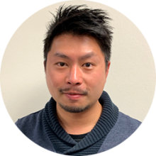
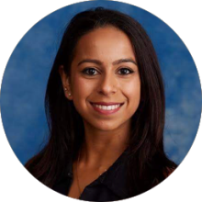
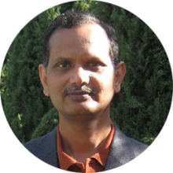
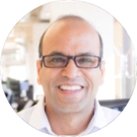
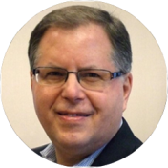
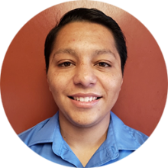
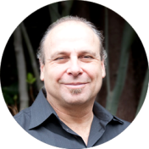
Our Team
Chief Executive Officer
Chief Technology Officer
Manu Mehta
Lynn Slater
High-tech entrepreneur and staffing veteran leading teams to disrupt new markets with innovative products and. services
Inventor with a proven track record with AI and big data. Has led Metabyte’s key developments for 16 years.
Dino Lau
Nitin Mehta
Director of User Experience
Director of Product Management
Master of front-end design who has been creating integral user experiences at Metabyte for 10 years.
Analytical problem solver with a penchant for applying emerging technology and creating business models for staffing.
Saiba Singh
Pradeep Gupta
Director of Customer Success
Data Scientist
Seasoned recruiter, marketing strategist, and research junkie who doesn’t miss any market details or customer needs.
Highly qualified data scientist with expertise in multiple verticals, implementing leading edge ML algorithms.
Satya Avala
Advisory Board
Dev Ops Manager
Experienced product and technology professional with a track record managing the technology stack at Yahoo Finance.
Adam Hyder
Senior VP of Engineering at Malwarebytes who previously led product development at BlueJeans, Jobvite and HotJobs.
Mrinal Chitithoti
Associate Product Manager
Resourceful and methodical problem solver who is focused on new product development and tracking key metrics.
John Mesberg
Recently retired from IBM as VP and GM of Watson Health after a career of managing product, technology, and business teams.
Quetzalcoatl Lira-Prado
Customer Success Specialist
Leon Warman
Energetic and fast paced worker excellent at driving business development and providing stellar customer service.
Tech Director at Amazon Robotics who previously led development of Alexa Engine and Prime Air drone delivery.

